Slide 1


Slide 2
Emade Consulting LLC
API Training

Slide 3
API
An API, or an application programming interface, is a set of code-based instructions that enable different software components to communicate and share data.
Developers use private, partner, and public APIs to bridge the gaps between small, discrete chunks of code in order to create applications that are powerful, resilient, and able to meet user needs.
APIs can be implemented with a wide range of architectures, protocols, and programming languages, which makes a strong API vocabulary essential for anyone who works with software. Use this API glossary to boost your API literacy and learn more about how APIs are designed, developed, deployed, and managed.

Slide 4
API access
API access is the ability to interact with an API, and it enables clients to request data, create or update resources, and execute specific operations. API access is often granted through API authentication mechanisms, such as API key authentication, JWT, and OAuth, which helps protect sensitive data and ensures the API's capabilities are not misused.
Some APIs will grant different levels of access to users according to their role. For instance, a user with the Admin role may have read and write access to every API endpoint, while a user with the Viewer role may only have read access to a select number of endpoints.

Slide 5
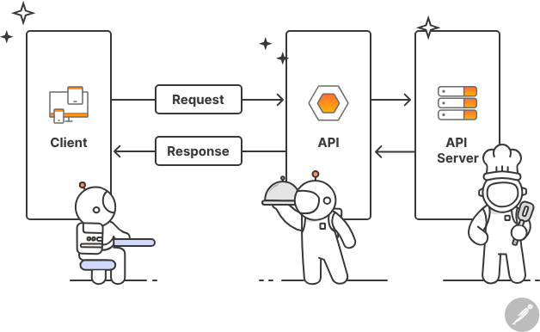
API authentication
API authentication is the process of verifying the identity of a user who is making an API request, and it is a crucial pillar of API security.
There are many types of API authentication, such as HTTP basic authentication, API key authentication, JWT, and OAuth, and each one has its own benefits, trade-offs, and ideal use cases.
Nevertheless, all API authentication mechanisms share the goal of protecting sensitive data and ensuring the API is not misused.

Slide 6
API Call
An API call, also known as an API request, is the mechanism through which a client application requests or sends data to an API.
An API call includes the endpoint URL and the HTTP method, as well as any headers, query parameters, or request body data.
The call is received by the API server, which processes it and returns a response.
The response can include the requested data, confirmation of a successful operation, or an error message if something went wrong.

Slide 7
API call …

Slide 8
API client
An API client is a development tool that makes it easier for producers and consumers to explore, test, and debug APIs.
Traditional approaches to calling an API require a significant amount of specialized knowledge; for instance, the API user must know a programming language, understand the API's framework and protocol, and be able to interpret the response.
This time-consuming process not only slows down API development and integration efforts but also prevents people with less technical backgrounds from working with APIs.
API clients abstract away some of this complexity, lowering the barrier to entry for API-related work and enabling developers to stay focused on big-picture goals.

Slide 9
API credentials
API credentials enable clients to identify themselves to an API server, and they are a crucial part of the API authentication workflow. When a client makes an API call, it includes credentials—such as a username/password pair, an API key, or a JWT—in the request.
The API server then validates the credentials and checks whether the client has the necessary permissions to perform the requested operation. If the API credentials are valid, the API server processes the request and returns the appropriate response.
API credentials therefore play an important role in API security by protecting the API and its data from unauthorized access.

Slide 10
API definition
An API definition is a human- and machine-readable document that describes the structure and behavior of an API, including its available endpoints, methods, parameters, data formats, and expected responses. API definitions can be written in various formats, such as OpenAPI (formerly known as Swagger), RAML (RESTful API Modeling Language), or API Blueprint.
API definitions play an essential role in the API design process, as they enable teams to align on the API's capabilities, use cases, and requirements. API definitions also provide the foundation for effective API documentation, which can help API producers attract new consumers and promote their APIs in the developer community.

Slide 11
API ecosystem
An API ecosystem is the network of APIs, developers, platforms, and services within a particular industry or organization.
Public API ecosystems may include API marketplaces and global developer communities, while private API ecosystems may include private API catalogs and internal standards and processes for API-related work.
API ecosystems are constantly evolving, which supports innovation and collaboration.

Slide 12
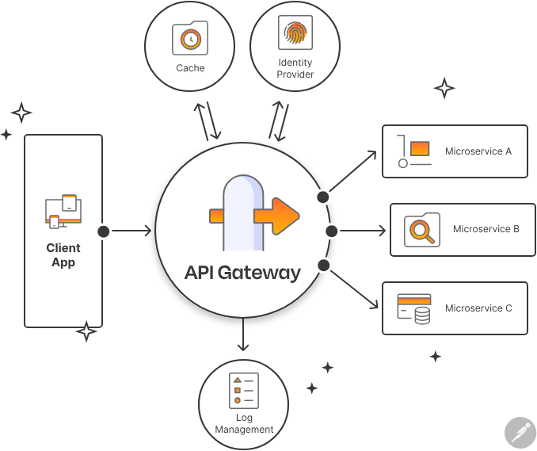
API gateway
An API gateway is a server that acts as an entry point for clients to access and interact with multiple microservices and backend systems. API gateways are an important component of microservice-based architectures, as they provide a centralized point of control for many common tasks that would otherwise be performed by each individual microservice. For instance, API gateways typically handle request routing, protocol translation, security, rate limiting, caching, load balancing, and API versioning. They can also provide various features—such as authentication, authorization, and analytics—to monitor and manage the usage of APIs. These capabilities enable developers to create a more scalable, resilient, and efficient system.

Slide 13
API headers
API headers contain the metadata that is sent along with an API request or response. They provide essential details that help the client and server communicate more effectively—and enable developers to customize and optimize the API's behavior. Some common examples of API headers include:
Authorization: Used to provide authentication information, such as a token or username and password.
Content-Type: Specifies the format of the data being sent in the request or response, such as JSON or XML.
Accept: Specifies the preferred data format that the client expects to receive in the response.
Cache-Control: Specifies caching directives, such as max-age and no-cache, for the response to be cached or not.
User-Agent: Specifies information about the client making the request, such as the browser or device used.

Slide 14
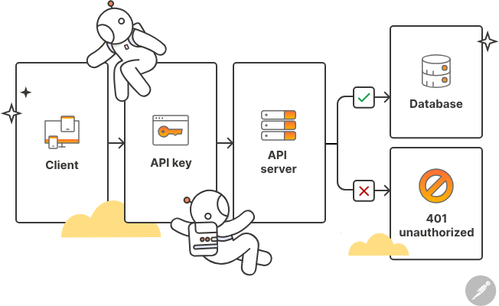
API key
An API key is a unique identifier that is used to authenticate and authorize access to an API.
An API key is passed along with each API request to identify the client and ensure it has the necessary permissions to interact with the relevant endpoint.
Some API keys grant full access to the API, while others may provide read-only access, write access, or access to specific features or endpoints in the API.
They may also be configured with usage limits that restrict the number of requests per day, or with expiration dates to ensure that access is revoked after a certain period of time.
API keys are commonly used by developers to access APIs that are provided by third-party services. By requiring an API key, the API provider can control access to their API, monitor usage, and restrict access to authorized users.

Slide 15
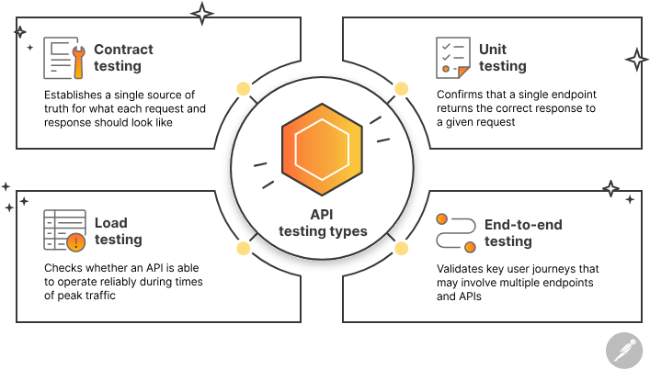
API testing
API testing is the process of validating that an API is working as expected. API testing can be performed manually on an ad-hoc basis, or it can be automated with a testing tool that executes test scripts at predetermined intervals or in response to events. Traditionally, API testing has occurred at the end of the development phase, right before changes are deployed to production, but an increasing number of teams are running tests earlier in the API lifecycle. This approach to API testing, which is known as "shifting left," supports rapid iteration by enabling teams to catch and remediate issues as soon as they are introduced.

Slide 16
API-first
API-first is a development model in which applications are conceptualized and built as a collection of internal and external services that are delivered through APIs. This strategy treats APIs as crucial infrastructure components, and it allows teams to leverage private, partner, and public APIs to bridge the gaps between small, discrete chunks of code to create applications that are powerful, resilient, and able to meet user needs.

Slide 17
API Cache
A cache is an infrastructure component that temporarily stores frequently accessed data so that it can be served more quickly and efficiently.
When an API client makes a request, the server can check the cache to see if the requested data is already available. If it is, the server can return the cached response directly to the client, without having to execute the full request again. This approach significantly improves the performance of the API by reducing the number of requests that the server needs to process, which minimizes latency and improves scalability.
There are many types of cache implementations, such as in-memory caches, disk-based caches, or distributed caches. They can also be configured with various caching policies— such as time-to-live (TTL), cache eviction, and cache invalidation—to ensure that the cached data remains fresh and up-to-date.

Slide 18
API request
An API request, also known as an API call, is a message an API client sends to an API server in order to retrieve or manipulate data. API requests typically include the following components:
Endpoint: An endpoint is a dedicated URL that provides access to a specific resource. For instance, the /products endpoint in an e-commerce app would include the logic for processing product-related requests.
Method: The method is the operation that the client would like to perform on the specified resource. REST APIs are accessible through standard HTTP methods, such as GET, POST, PUT, PATCH, and DELETE, which facilitate common actions like retrieving, creating, updating, or deleting data.
Parameters: Parameters are variables that are passed to an API endpoint, and they provide specific instructions for the API to process. For instance, a request to an online food delivery app might accept a “location” parameter, which it would use to return restaurants in a certain location.
Headers: Headers provide additional information about the request. For example, they might be used to specify the data format in the request's body or to pass authentication credentials.
Body: The request body is optional, and it is only included when the client needs to create, update, or delete a resource. If it is present, it includes the data that the client wants to create or manipulate.

Slide 19
CRUD
CRUD, which stands for Create, Read, Update, and Delete, refers to a set of basic operations that can be performed on data in a database or other data storage system. CRUD operations are most frequently performed with five standard HTTP methods: GET, POST, PUT, PATCH, and DELETE. CRUD is a fundamental concept in software development and is used to manage data in a wide range of applications, such as content management systems, e-commerce websites, social media platforms, and more.
The CRUD operations are:
Create: This operation is used to create data in a system, such as a new user account, a new blog post, or a new product. It is typically performed with the POST method.
Read: This operation is used to retrieve data, such as a list of all users, a single blog post, or a specific product. It is typically performed with the GET method.
Update: This operation is used to make modifications to existing data, such as updating a user's account information, editing a blog post, or changing the price of a product. It is typically performed with the PUT or PATCH methods.
Delete: This operation is used to remove data, such as a user account, a blog post, or a product. It is typically performed with the DELETE method.

Slide 20
HTTP
HTTP, which stands for Hypertext Transfer Protocol, is a standardized protocol for transmitting data—such as HTML pages, images, and videos—between clients and servers on the internet.
HTTP works on the client-server model, where the client sends an HTTP request to the server and waits for a response.
HTTP uses a standard set of request methods, such as GET, POST, PUT, and DELETE, to specify the type of action the client would like to perform on a given resource.
HTTP requests are typically initiated by clicking on a link, entering a URL into a browser's address bar, or submitting a form. The browser sends the request to the server, which processes the request and sends a response back to the client. The response includes a status code that indicates whether the request was successful. If so, the response will also contain the actual data that was requested.

Slide 21
JSON
Here is an example of a JSON object that represents a person:
In this example, the JSON object has several key-value pairs, including name, age, address, email, and phoneNumbers. The address field is itself an object, with several nested key-value pairs, while the phoneNumbers field is an array of objects.
{
"name": "John Smith",
"age": 35,
"address": {
"street": "123 Main St",
"city": "Anytown",
"state": "CA",
"zip": "12345"
},
"email": "john.smith@example.com",
"phoneNumbers": [
{
"type": "home",
"number": "555-1234"
},
{
"type": "work",
"number": "555-5678"
}
]
}
JSON, which is pronounced "JAY-son" and stands for JavaScript Object Notation, is a lightweight, text-based data format that is easy for humans and machines to read and write. JSON is based on the JavaScript programming language syntax and uses key-value pairs to represent data objects. JSON keys are strings, and their values can be strings, numbers, booleans, arrays, or another JSON object. The key-value pairs are separated by commas, and objects are enclosed in curly braces.
JSON has become a popular format for transmitting data over the internet because of its simplicity, compactness, and readability. It is supported by many programming languages and platforms, and it is often used in RESTful APIs to transmit data between servers and clients.

Slide 22
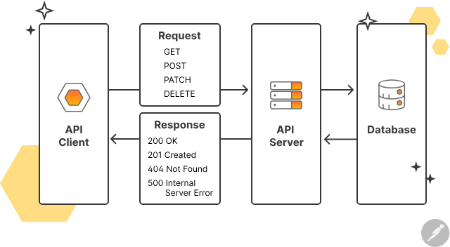
RAML
RAML, which stands for RESTful API Modeling Language, is a specification language that is used to define RESTful APIs. It provides a way to document the resources, methods, parameters, and responses of an API in a structured and machine-readable format. RAML supports a wide range of features, including URL routing, request/response models, media types, security, and more. It is also highly extensible, with a range of tools and libraries available for developers to build and customize their own RAML-based solutions.

Slide 23

REST API interview questions

Slide 24
API
APIs are the building blocks of modern applications, and it’s becoming more common to see “knowledge of REST APIs” listed as a requirement in job descriptions—even for non-developer roles. In fact, Postman’s 2023 State of the API Report found that 53% of people who work with APIs are non-developers. So, whether you’re applying to be an engineer, product manager, data analyst, or customer success manager, these answers to ten of the most common REST API interview questions will help you navigate the interview process with confidence.

Slide 25
What is REST?
REST (Representational State Transfer) is the most used architectural style for building web services and APIs. In a RESTful architecture, resources are identified by URIs (Uniform Resource Identifiers), and operations are performed on those resources using standard HTTP methods. The state of a resource is represented in JSON or XML, which is transferred between the client and server in the HTTP request and response bodies.

Slide 26
What is the relationship between HTTP and REST?
HTTP, which stands for Hypertext Transfer Protocol, is the dominant protocol for transmitting data between clients and servers on the internet.
HTTP operates on a stateless request-response model, in which the client sends a request to the server and the server responds accordingly—without any knowledge of the client’s previous requests.
REST emphasizes standardized, stateless interactions between clients and servers, which makes HTTP the ideal choice for implementing RESTful principles

Slide 27
What is the difference between REST and SOAP?
REST and SOAP are two different architectural styles for building APIs.
REST is a highly flexible approach that uses standard HTTP methods to interact with resources that are represented in JSON or XML.
In contrast, SOAP is an XML-based messaging protocol that is used to transfer data between distributed applications and systems, and it follows a very strict structure. REST is more popular than SOAP, but SOAP is still used in many enterprise-scale systems that require advanced security and error handling features.

Slide 28
What are HTTP headers, and which ones are most commonly used?
HTTP headers contain the metadata that is included in an API request or response.
These key-value pairs provide essential details that help the API client and server communicate more effectively—and enable developers to customize and optimize the API’s behavior.
Some of the most common request headers are Accept, which defines the media types that the client is able to accept from the server; Authorization, which is used to send the client’s credentials to the server when the client is attempting to access a protected resource; and Content-Type, which defines the media type in the request body.
The server also includes HTTP headers in its response to the client. Some of the most common response headers include Cache-Control, which defines how the response should be cached, and Set-Cookie, which instructs the client to store a cookie with the specified attributes.

Slide 29
What is a resource in a RESTful context?
A REST resource is any object or group of objects that can be accessed through a dedicated API endpoint. For instance, a simple blog API may have an author resource. Individual authors may be accessed via the /authors/:id endpoint, while the collection of all authors may be accessed via the /authors endpoint.
In a well-designed RESTful API, resources and their associated endpoints should follow standard naming conventions and represent a logical entity that makes sense in the context of the application. Proper representation of resources is crucial for building an API that can be easily maintained and consumed.

Slide 30
What are some defining features of REST APIs?
REST APIs have several characteristics that promote efficiency, scalability, and interoperability. One key feature is statelessness, which means that every request from the client includes all necessary information, and the server doesn’t store any client-specific data. This behavior allows servers to handle client requests without managing complex session data, which simplifies server design and promotes horizontal scalability.
Another important aspect of REST APIs is the separation of concerns between the client and server. A REST API client is responsible for the user interface and user experience, while the API server handles request processing and resource management. This clear delineation ensures modularity and enables each component to evolve independently.
Finally, all REST APIs have a uniform interface in which endpoints are accessed with an established set of HTTP methods. This consistency promotes API integration, as any client that supports HTTP can use a RESTful API—regardless of its platform or programming language. The uniform interface also makes REST APIs easier to maintain and accelerates the onboarding process for new consumers.

Slide 31
What is the difference between the PUT and PATCH methods?
The PUT and PATCH methods are both used to modify resources, but they handle updates differently. The PUT method works by replacing a resource with the data that is included in the request body. This means that any fields or properties not included in the request body are deleted, and any new fields or properties are added.
In contrast, the PATCH method is used for making partial updates to a resource. For instance, if you have a movie resource with fields for title, year, and rating, but you only want to update the rating, you could use the PATCH method to send a request that only includes the new value for the rating field. The rest of the resource would remain unchanged. This behavior reduces the amount of data that must be transferred, which makes PATCH more efficient than PUT.

Slide 32
What is idempotency in a RESTful context?
An HTTP method is considered idempotent if it will result in the same outcome no matter how many times it is executed.
All read-only methods are idempotent, as are PUT and DELETE. However, POST and PATCH are not idempotent.
POST is not idempotent because calling it multiple times will result in multiple resources being created.
PATCH can be idempotent, but it is not necessarily so. For instance, a PATCH request may increment a specific field every time it is called, which would modify the resource every time.

Slide 33
What are the most common HTTP status codes?
HTTP status codes are three-digit numbers included in the server’s response that indicate the result of a client’s request. Some of the most common HTTP status codes include:
200 OK: The request was successful, and the response includes the requested data.
201 Created: The request was successful, and the server has created a new resource with the provided data.
204 No Content: The request was successful, but there is no additional data to send in the response. This code is often used in response to DELETE requests.
400 Bad Request: The server cannot understand the request due to a client error, malformed syntax, or invalid parameters.
401 Unauthorized: The client lacks valid credentials to access the requested data or perform the desired action.
403 Forbidden: The client does not have permission to access the requested resource, even with valid authentication credentials.
404 Not Found: The server cannot find the requested resource or endpoint.
500 Internal Server Error: The server encountered an unexpected issue.
503 Service Unavailable: The server is not ready to handle the request, often due to overload or maintenance.
504 Gateway Timeout: The server acting as a gateway or proxy did not receive a timely response from the upstream server.

Slide 34
What are the advantages and drawbacks of statelessness in REST?
Statelessness is a hallmark trait of REST APIs, and it has many benefits. REST API servers don’t need to manage session data, which allows them to handle a large number of concurrent requests and supports horizontal scaling. This also leads to streamlined server logic and faster response times.
Statelessness has a few drawbacks, as well. Requests to a REST API may have larger payloads, as the client must include all of the necessary information. This may have a negative impact on network performance. Statelessness may also require clients to handle retries in the case of network or server failures, as there is no server-side context to help with these error scenarios.

